Slide 1
Implementing A Pointing Model for the South Pole Telescope
Rita Ezeugwu
Mentor: Christopher Greer
Notes:
Marrone?
Pictures

Slide 2
Introduction
Activity observed in the center of the Milky Way – massive black hole
Supermassive Sagittarius A* (Sgr A*) is studied to learn about the accretion of material affected by its gravitational environment
Knowing the characteristics of Sgr A* provides a deeper understanding of astrophysics and scientific principles that describe general relativity
Notes:
Discovered a few decades ago in center of milky way
Explain black holes
How it may affect planets, stars, asteroids that are near it

Slide 3
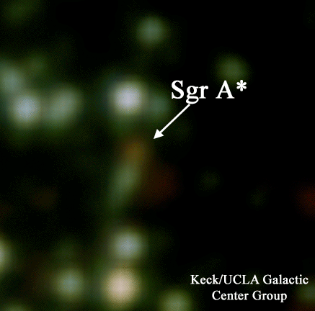
Sagittarius A*
Notes:
Explain how and when these images were taken

Slide 4
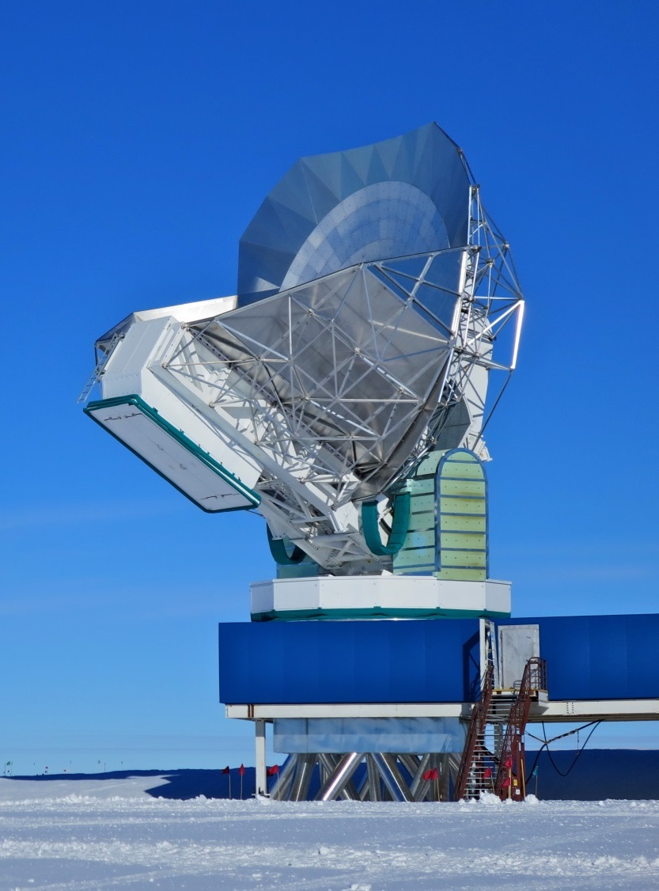
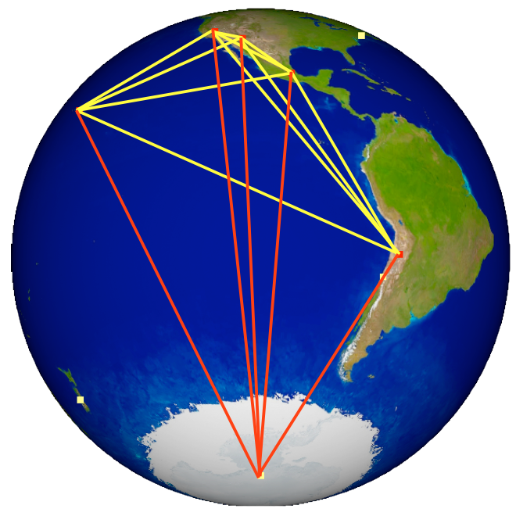
South Pole Telescope
South Pole Telescope (SPT) points towards Sgr A* for observation
Event Horizon Telescope (EHT) network
Source: Christopher Greer
Source: http://t.co/gUpo5hAcZR
Notes:
Spt part of telescope network
Goal:

Slide 5
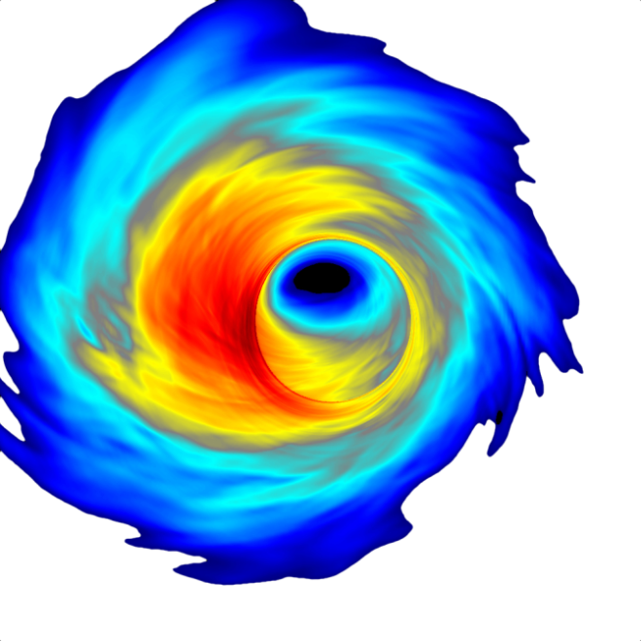
Objective
Correct atmospheric and telescope pointing offsets associated with SPT to clearly locate Sgr A* by using an online pointing model
Apply an updated pointing model for SPT to detect other discrete objects for collaboration with EHT observations.
Obtain data of Southern Sky
Source: Christopher Greer
Notes:
Skew axis
Collimation
Tilting/sagging

Slide 6
Methodology
Collect the brightest and most compact point sources with Planck Catalogue of Compact Sources (PCCS)
Frequencies: 217 GHz, 353 GHz
Selection of point sources
Filtered with MATLAB
Position
Brightness
Angular extent
Set of Identifications, Measurements, and Bibliography for Astronomical Data (SIMBAD)
Notes:
Overcome systematic errors with pointing model
Interested in online pointing
Conical scanning-involves antenna tracing cone path (circular) that is offset to object of interest; for accuracy purposes.
(get past through atmosphere)
Explain “calibration”

Slide 7
SIMBAD: 217 GHz Data Point
Identifier: [PAH2004] I
Coordinates: 272.155 -19.866
Radius : 1 arcmin
Source: http://simbad.u-strasbg.fr/
Notes:
RA/DEC coordinate explanation

Slide 8
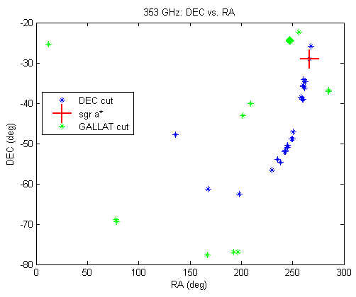
Results
217 GHz (left) and 353 GHz (right) data
Notes:
217 GHZ
Why the green sources?

Slide 9
Conclusion
Now have collection of sources to observe
Future work
Create software that analyzes the list of calibration observations to produce pointing model parameters
March 2015
Notes:
Did methodology work?

Slide 10
Acknowledgements
UA NASA Space Grant Program
Barron Orr
Susan Brew
UA Department of Astronomy
Dr. Daniel Marrone

Slide 11
Thank You!

